Slide 1
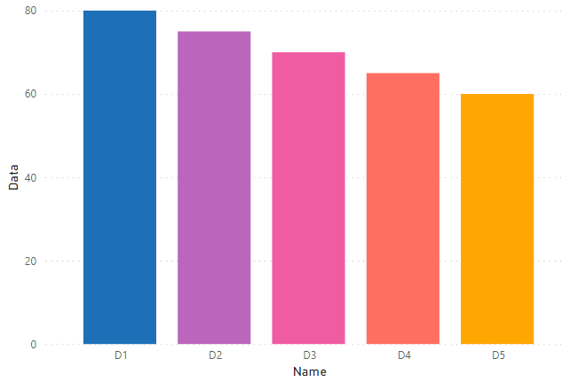
1st | = | #1D70B8
2nd | = | #BC65BD
3rd | = | #F05CA1
4th | = | #FF6F61
5th | = | #FFA600

Slide 2
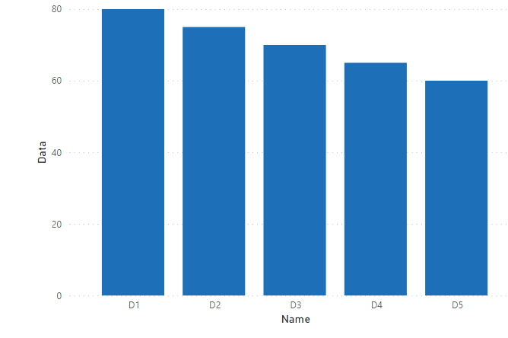
1st | = | #1D70B8

Slide 3
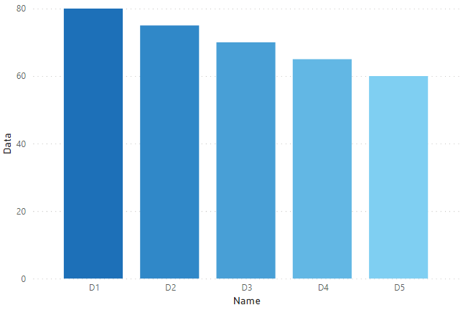
1st | = | #1D70B8
2nd | = | #3088C8
3rd | = | #489FD6
4th | = | #62B7E4
5th | = | #7FCFF2

Slide 4
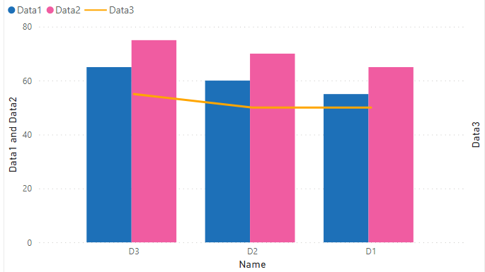
1st | = | #1D70B8
2nd | = | #F05CA1
3rd | = | #FFA600

Slide 5
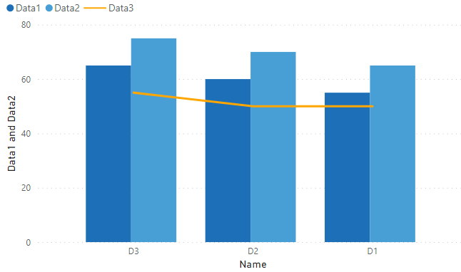
1st | = | #1D70B8
2nd | = | #489FD6
3rd | = | #FFA600

Slide 6
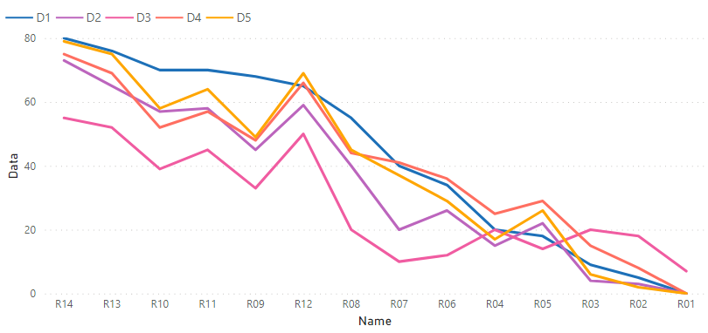
1st | = | #1D70B8
2nd | = | #BC65BD
3rd | = | #F05CA1
4th | = | #FF6F61
5th | = | #FFA600

Slide 7
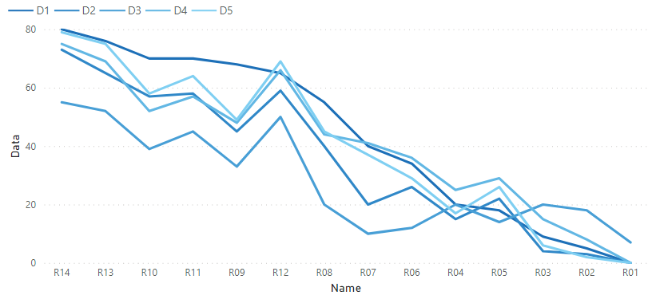
1st | = | #1D70B8
2nd | = | #3088C8
3rd | = | #489FD6
4th | = | #62B7E4
5th | = | #7FCFF2

